Slide 1

SJM POLYTHENIC CHITRADURGA
EMOTION BASED MUSIC RECOMMENDATION
Presented By:
Himanshu B A 335CS20005
Prashanth N 335CS20007
Surya D 335CS20035
Anurageshwar E 335CS20036
Under the Guidance of :
Smt. Sudha G K

Slide 2

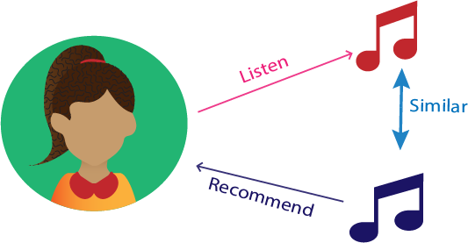
EMOTION BASED MUSIC RECOMMENDATION

Slide 3
Table of contents
01
Introduction
02
Research Problem Stat
03
Technological Implementation
04
Research Methodology
05
Data Collection & Analysis
06
Results
07
Conclusion
08
Meet our Team

Slide 4
Introduction
01
Human emotion detection is a very challenging field that target methods to make effective human computer interaction. We know that emotions play a major role in a Human life. At different kind of moments or time human face reflects that how he/she feels or in which mood he/she is .
Here we use an existing simulator which will be able to capture human emotions by reading or comparing facial expressions

Slide 5
HUMAN EMOTIONS
02

Slide 6
HUMAN EMOTIONS
02
Emotion is soften intertwined with mood, temperament, disposition, and motivation. Human emotions help us cope with everyday life, allowing us to communicate what we feel toward certain situations, people, things, thoughts, senses, dreams, and memories..
Many psychologists believe that there are six main types of emotions, also called basic emotions. They are happiness, angry, fearful, sadness and surprise.

Slide 7
Technological Implementation
03
Tensor Flow | NumPy | Media Pipe | OpenCV

Slide 8


OpenCV
01
OpenCV (Open Source Computer Vision Library) is an open-source computer vision and image processing library.
It provides a comprehensive set of functions and algorithms that enable developers to efficiently process and analyze images and videos.
NumPy
02
NumPy (Numerical Python) is a Python library for scientific computing and numerical operations.
It provides support for large, multi-dimensional arrays, along with a collection of mathematical functions to operate on these arrays efficiently.

Slide 9


Tensor Flow
03
TensorFlow is an open-source deep learning framework developed by Google.
It provides a comprehensive ecosystem for building and deploying machine learning models, with a particular focus on neural networks.
Media Pipe
04
Media Pipe is an open-source framework developed by Google.
It provides a cross-platform solution for building real-time media processing pipelines.
It offers a wide range of pre-built components and algorithms for tasks.

Slide 10
Research Methodology
04
Transforming interaction with hand gestures

Slide 11

Architecture of System
Input Layer: The input layer of the system captures the face gestures in image or video format. The format depends on the application.
Preprocessing Layer: The input data is preprocessed to remove noise and enhance features. This can be done with techniques like color correction, enhancement, filtering, and normalization.
Face Detection Layer: Face detection layer uses deep learning to find Face in input data. Output is bounding box of Face location.

Slide 12
Architecture of System
Landmark Detection Layer: After detecting the Face, the landmark detection layer identifies the key points on the Face using machine learning. The output is a set of 3D coordinates of the Face landmarks.
Emotion Recognition Layer: The Face Emotion recognition layer uses machine learning to Face Emotion. It can be trained on large datasets. The output is a label for the recognized with emotion.
Output Layer: The output layer of the system displays the recognized Face Emotion and gives the song recommendation.

Slide 13
Flow Chart
Image Frame Acquisition
Face Segmentation
Face Tracking
1
2
3
Output Face Emotion and song recommendation
Face Emotion Classification
Feature Extraction
6
5
4

Slide 14
Data Collection & Analysis
05
Transforming interaction with hand gestures

Slide 15

Instruments for Data Collection
The most common instruments used for hand gesture recognition include:
Cameras are commonly used to recognize and interpret hand gestures. They capture images of the face, which are then analyzed. RGB, depth, and thermal cameras are commonly employed for this purpose.
Computer vision libraries like OpenCV and Media Pipe offer pre-built tools for analyzing and processing image and video data, including pre-trained models for Face Emotion recognition.
Machine learning trains models to recognize and interpret face emotion using large datasets, enabling pattern recognition and predictions for new data.

Slide 16
Results & Improvements
06
Transforming interaction with hand gestures

Slide 17
Results
Accuracy: Measure the accuracy of the face recognition system in correctly identifying and classifying different emotion.
Real-time Performance: Evaluate the system's ability to process face gestures in real-time, ensuring timely and responsive recognition.
Robustness: Assess the system's reliability and stability across various environmental conditions, such as lighting variations or background noise.
User Experience: Gather feedback from users to evaluate the system's ease of use, intuitiveness, and overall satisfaction.

Slide 18
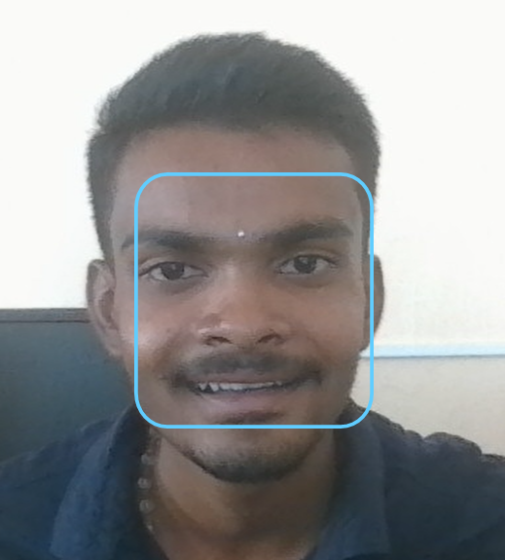
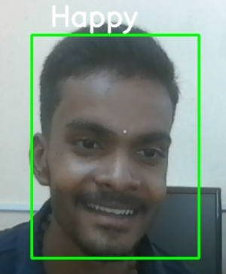
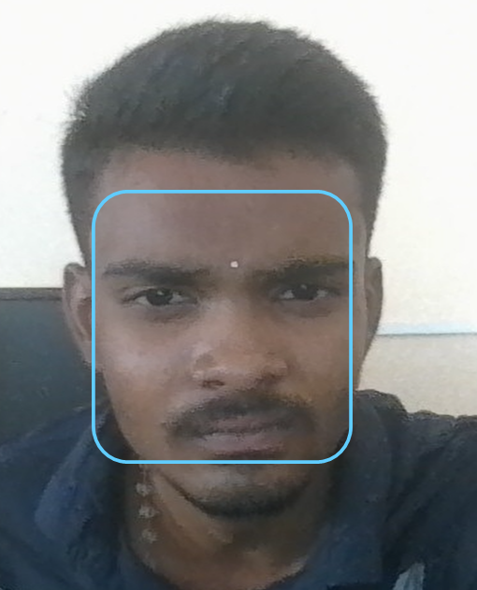

Examples
D
E
T
E
C
T
HA
P
P
Y
D
E
T
E
C
T
S
A
D

Slide 19
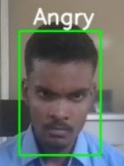

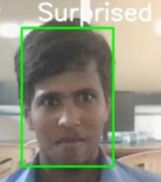


ANGRY
HAPPY
SUPRISED
FEARFUL
SMILE

Slide 20
Conclusion
07

Slide 21
Conclusion
07
In conclusion, face recognition using Media Pipe is a promising technology that can be used in a wide range of applications.
By leveraging the power of computer vision and machine learning, our team can enable natural and intuitive interactions with technology.
As the technology continues to evolve and improve, we can expect to see even more innovative applications of face recognition in the future.

Slide 22
Meet Our Team
08
Prashanth
N
Himanshu
B A
Surya D
Anurag
Eshwar E

Slide 23
Thank You

